Slide 1
Topic 08: Data Visualization
BDM3302: Data Management

Slide 2

What is Data Visualization?
The representation of data through use of common graphics, such as charts, plots, infographics, and even animations
These visual displays of information communicate complex data relationships and data-driven insights in a way that is easy to understand
Data visualization can be utilized for a variety of purposes, and it is important to note that is not only reserved for use by data teams
Management also leverages it to convey organizational structure and hierarchy while data analysts and data scientists use it to discover and explain patterns and trends

Slide 3
Why Data Visualization?
Harvard Business Review categorizes data visualization into four key purposes:
Idea generation
Idea illustration
Visual discovery
Everyday dataviz

Slide 4
Why Data Visualization?
Idea generation
Commonly used to spur idea generation across teams
Frequently leverage during brainstorming or design thinking at the start of a project by supporting the collection of different perspectives and highlighting the common concerns of the collective
While these visualizations are usually unpolished and unrefined, they help set the foundation within the project to ensure that the team is aligned on the problem that they’re looking to address for key stakeholders

Slide 5
Why Data Visualization?
Idea illustration
Assists in conveying an idea, such as a tactic or process
Commonly used in learning settings, such as tutorials, certification courses, centers of excellence, but it can also be used to represent organization structures or processes, facilitating communication between the right individuals for specific tasks
Project managers frequently use Gantt charts and waterfall charts to illustrate workflows

Slide 6
Why Data Visualization?
Visual discovery and Every dataviz
While visual discovery helps data analysts, data scientists, and other data professionals identify patterns and trends within a dataset, every day dataviz supports the subsequent storytelling after a new insight has been found
Data visualization is a critical step in the data science process, helping teams and individuals convey data more effectively to colleagues and decision makers
However, it’s important to remember that it is a skillset that can and should extend beyond your core analytics team

Slide 7
Type of Data Visualizations
Tables: This consists of rows and columns used to compare variables. Tables can show a great deal of information in a structured way, but they can also overwhelm users that are simply looking for high-level trends
Pie charts and stacked bar charts: These graphs are divided into sections that represent parts of a whole. They provide a simple way to organize data and compare the size of each component to one other
Line graphs and area charts: These visuals show change in one or more quantities by plotting a series of data points over time. Line graphs utilize lines to demonstrate these changes while area charts connect data points with line segments, stacking variables on top of one another and using color to distinguish between variables

Slide 8
Type of Data Visualizations
Histograms: This graph plots a distribution of numbers using a bar chart (with no spaces between the bars), representing the quantity of data that falls within a particular range. This visual makes it easy for an end user to identify outliers within a given dataset
Scatter plots: These visuals are beneficial in reveling the relationship between two variables, and they are commonly used within regression data analysis. However, these can sometimes be confused with bubble charts, which are used to visualize three variables via the x-axis, the y-axis, and the size of the bubble
Heat maps: These graphical displays are helpful in visualizing behavioral data by location. This can be a location on a map, or even a webpage
Tree maps: Display hierarchical data as a set of nested shapes, typically rectangles. Tree maps are great for comparing the proportions between categories via their area size

Slide 9

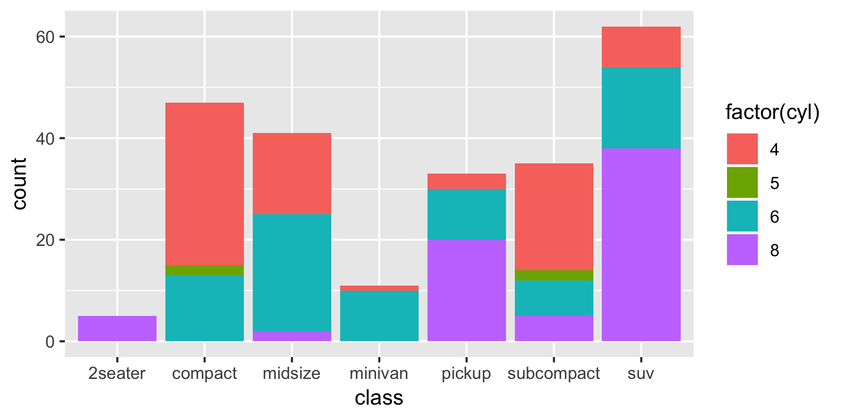
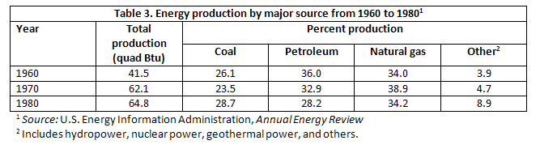
Type of Data Visualizations
Tables
Pie Charts
Stack Bar Charts

Slide 10

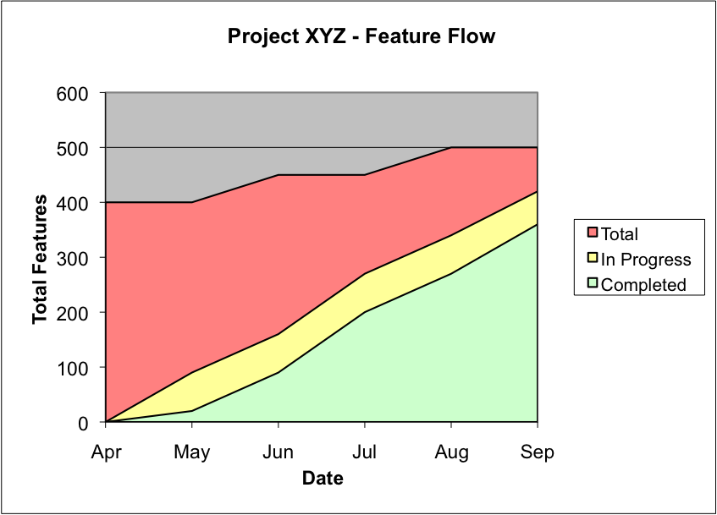
Type of Data Visualizations
Line Graphs
Area Charts

Slide 11
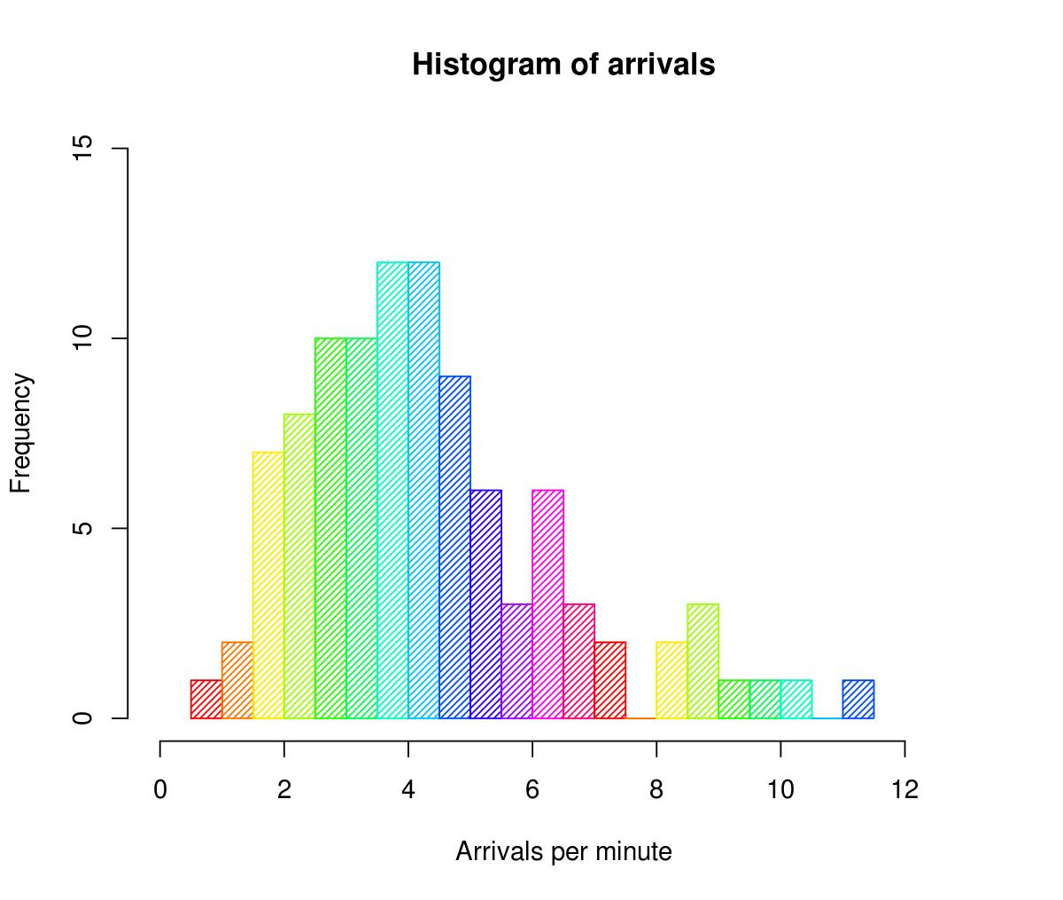
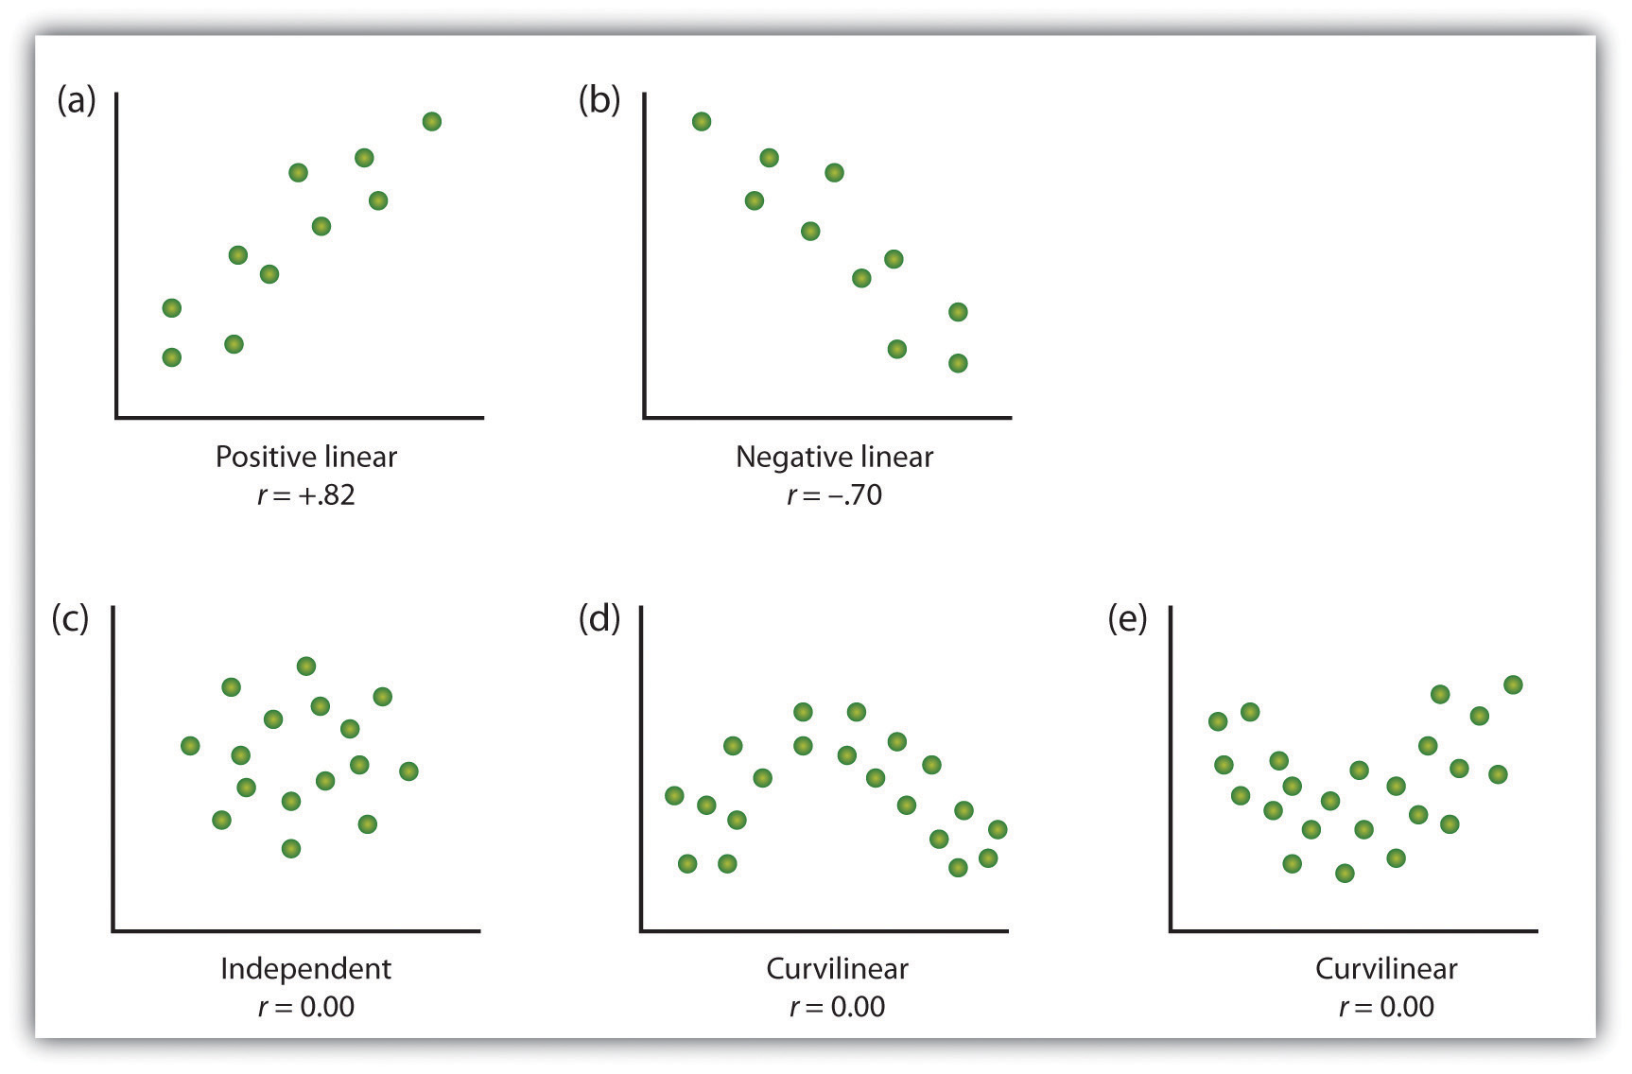
Type of Data Visualizations
Histograms
Scatter Plots

Slide 12
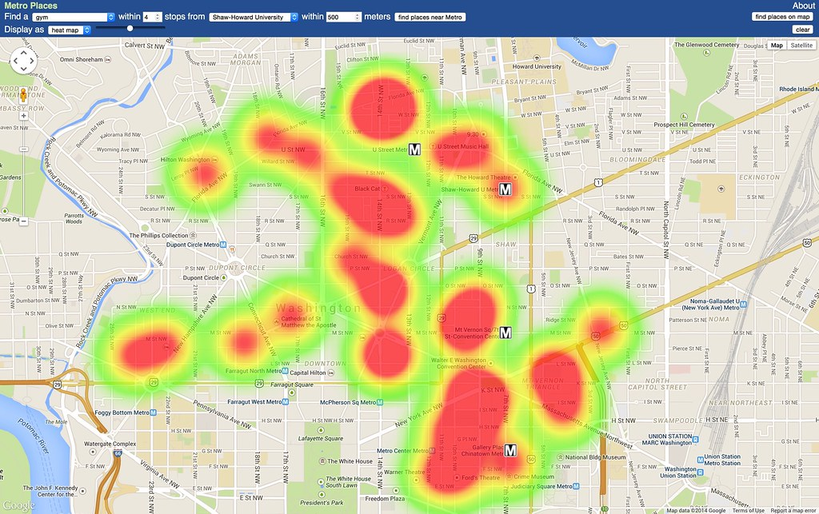
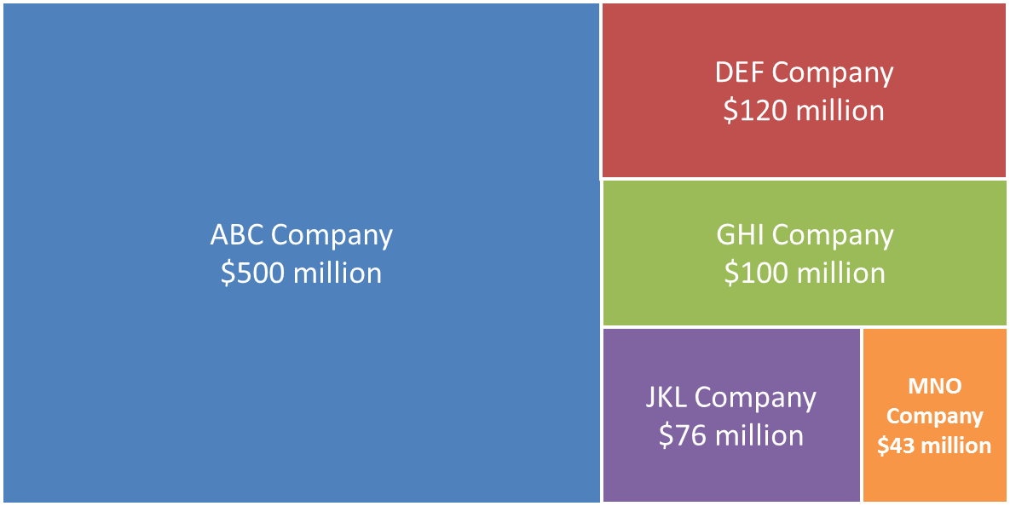
Type of Data Visualizations
Heat Maps
Tree Maps

Slide 13
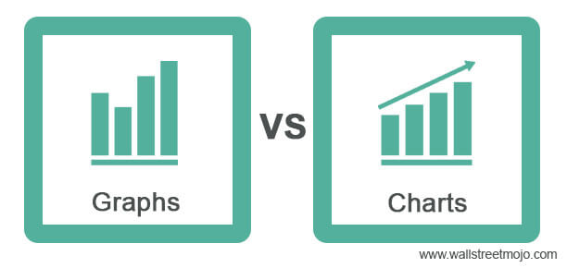
Graphs vs Charts
Plot number in x,y axis
Compare and run trends

Slide 14
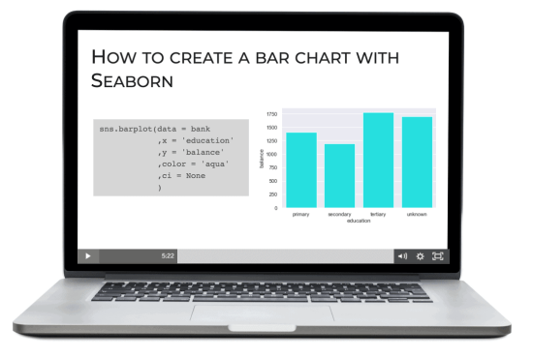
How to create Data Visualization?
In this era of big data, businesses need a data visualization tool that would solve all their visualization needs
The effectiveness of any data visualization tool lies in the richness of data visualization capabilities that it offers
There are four basic data visualization tools you should know: Excel, Tableau, Google Data Studio, Power BI

Slide 15




Data Visualization Tools
Create interactive graphs, stunning maps, and live dashboards in minutes. Support both cloud and public desktop (free).
Basic spreadsheet tool which is ease of use to collect data but cannot enhance in huge amount of data.
Easily connect to, model, and visualize your data. Get fast, AI-powered answers to your business questions. But require paid subscription version when you would like to share for collaboration.
Simple and nice with collaboration. Huge amount of data can be accepted and free of charge but based on web browser.

Slide 16
Which tool do we use in lab class?
We decide to choose Tableau due to free of charge for education use (Power BI requires paid subscription before sharing)
There is the Public Desktop as a free version for you to download in your own desktop or laptop at home (This version can save file in Tableau Public Cloud only)
It can be easily to share the link to the audiences that open from cloud directly
Inside computer lab room SC0501 & SC0502, there is the full usage educational license for Professional Desktop version (apply year by year)

Slide 17
Public Desktop vs Professional Desktop
Public Desktop
Essentially a free version of Tableau visualization tool
It allows you to use most of the tool functions
You can create visualizations and connect to CSV, Text and Excel documents
The largest difference is that Tableau Public does not allow you to save your workbooks locally
Professional Desktop
The professional version of this can transform, process and store huge volumes of data which is responsible for all the data-driven decision making of an organization
You can create visualizations for full edition and can save in desktop or laptop computer
Require paid subscription
Computer lab room SC0501 & SC0502 has already set for the educational license

Slide 18
Set up Tableau Public Desktop at home (Quick Install)
Go to this website and click orange button “DOWNLOAD THE APP” and then click “DOWNLOAD THE APP” again
Register your personal information and then click “DOWNLOAD THE APP” again to download the app
When the app is downloaded, double click file to install and follow the instruction until complete

Slide 19
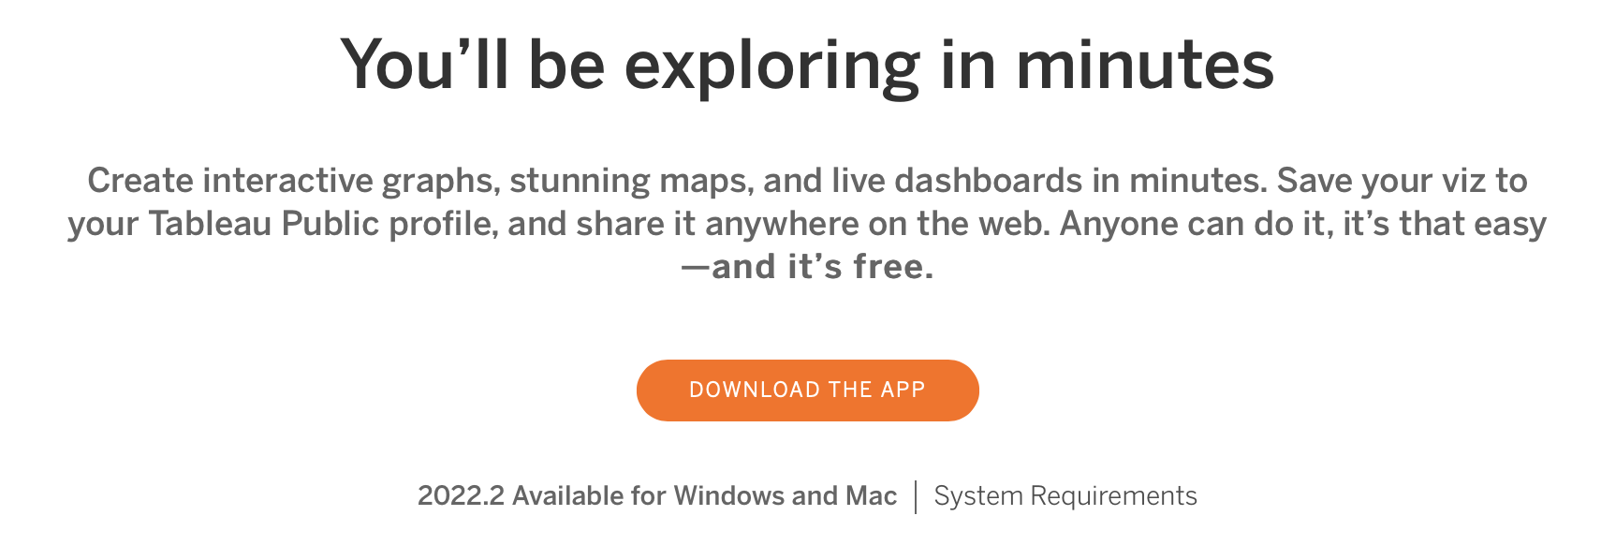
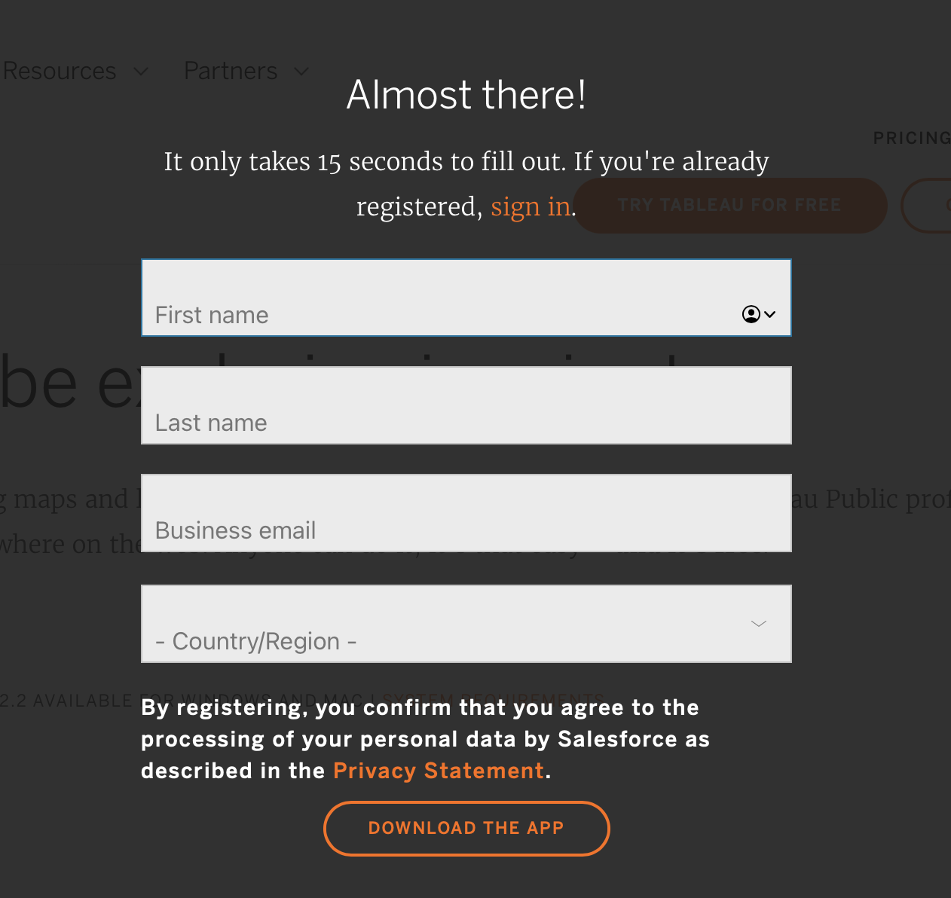

Set up Tableau Public Desktop at home (Quick Install)
Input your personal information,
and then click “DOWNLOAD THE APP”

Slide 20
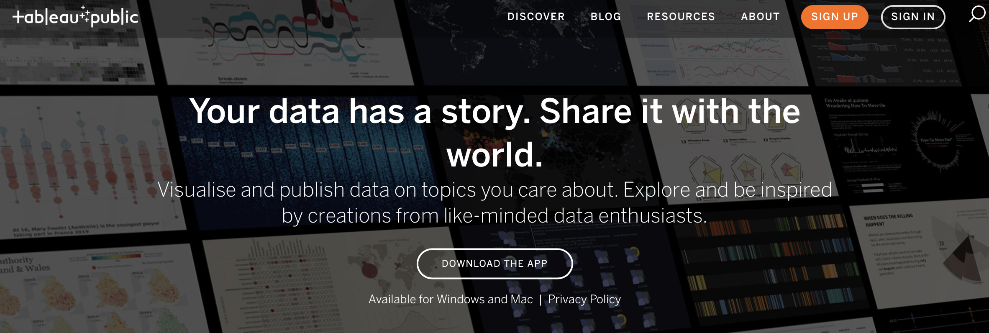
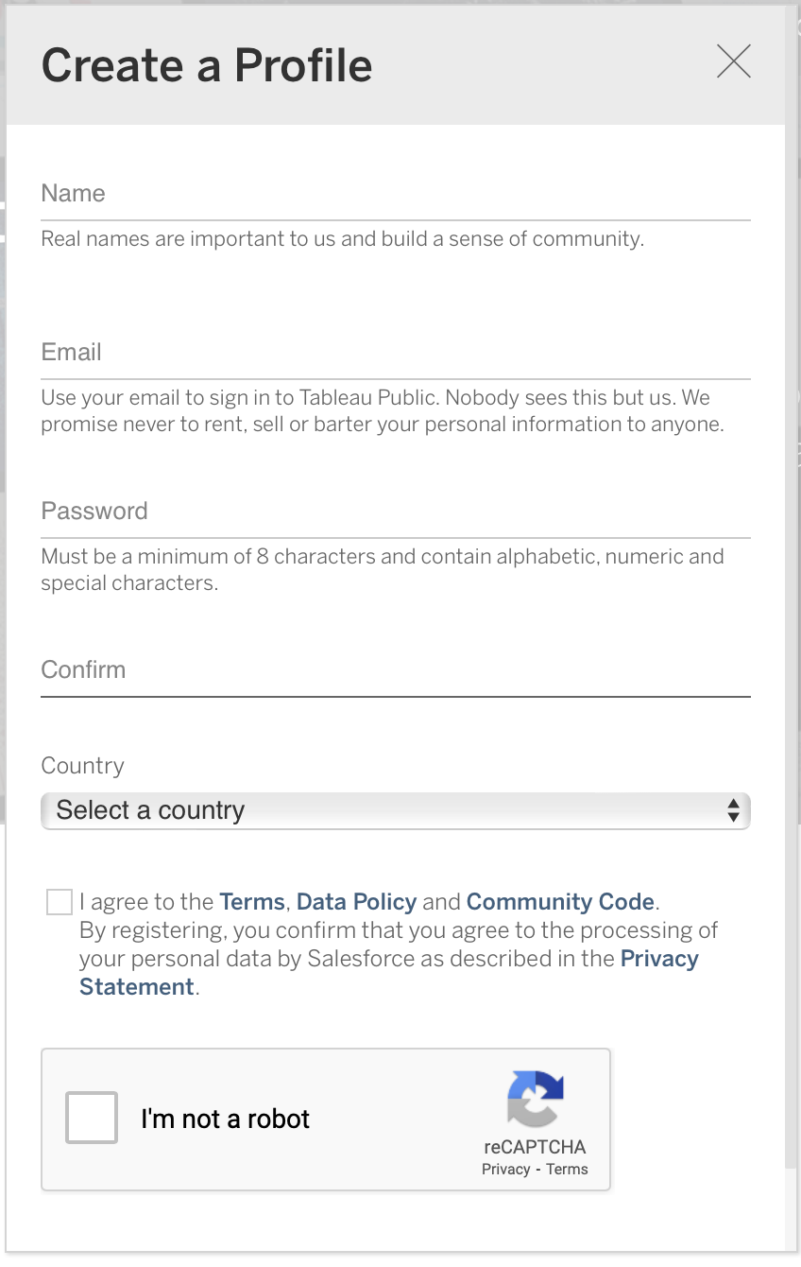
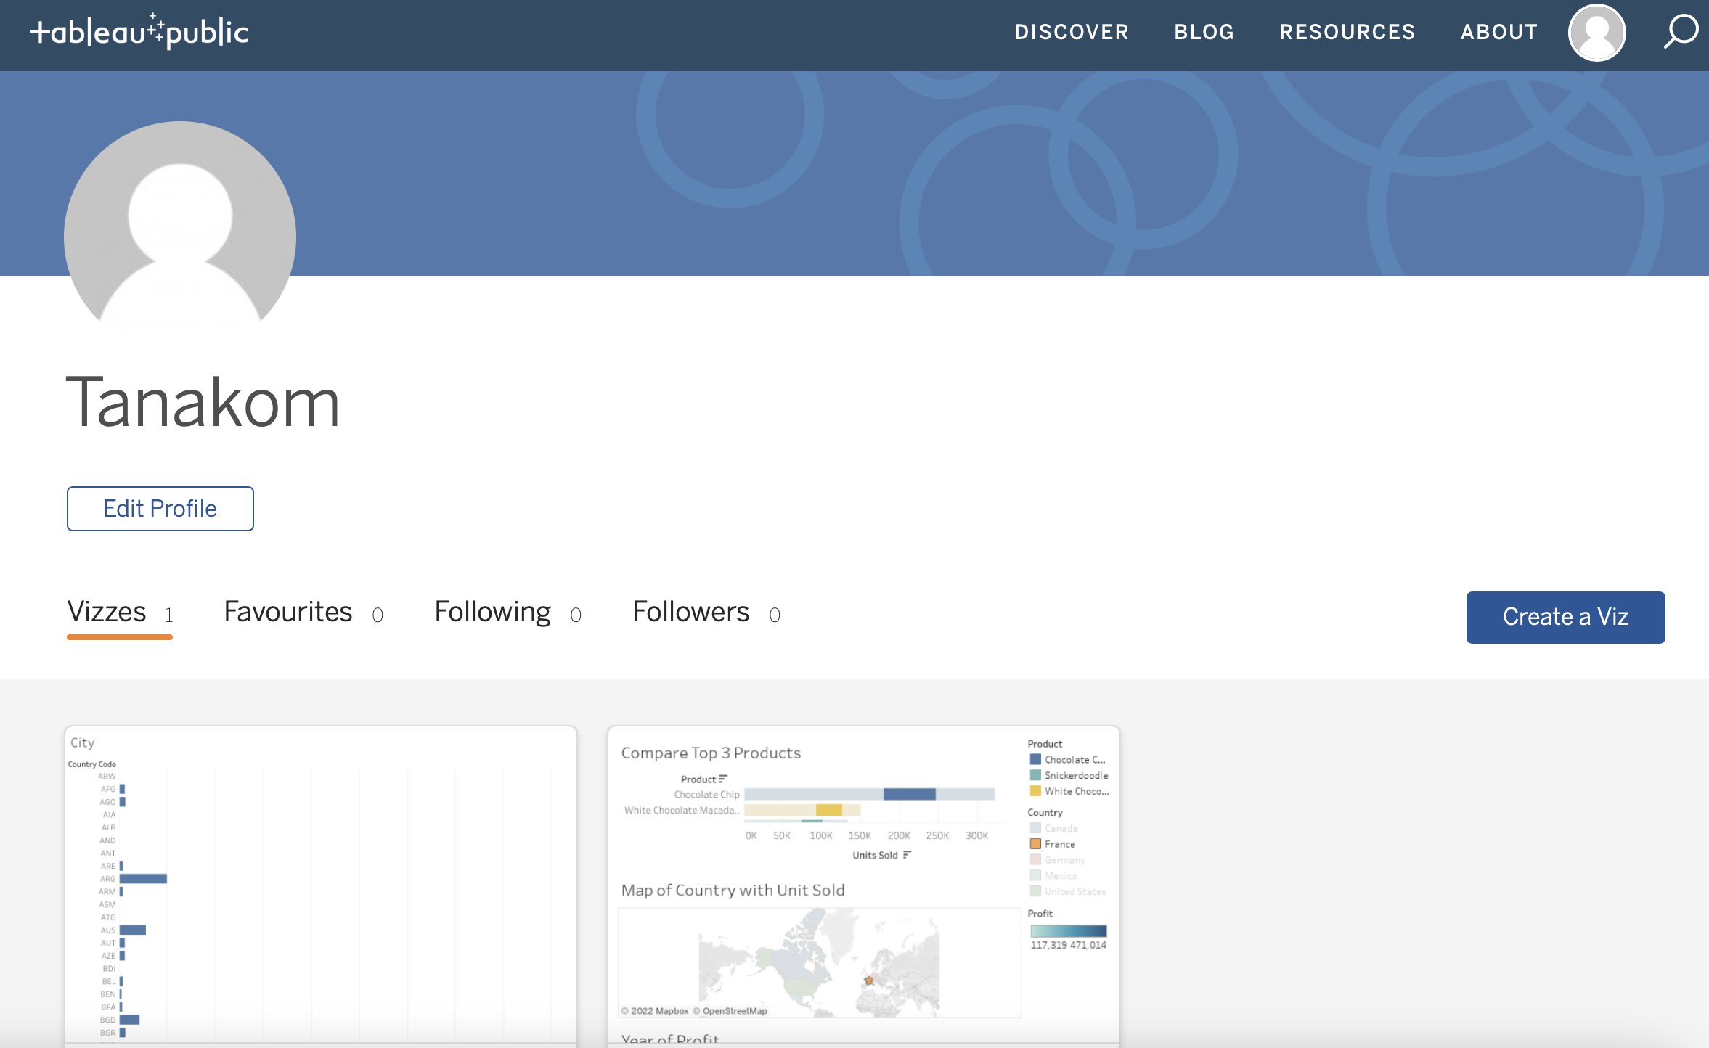

Set up Tableau Public Desktop at home (Quick Register)
When you sign in, the screen will display like this …
Regist your personal information,
and then click “Create My Profile”

Slide 21
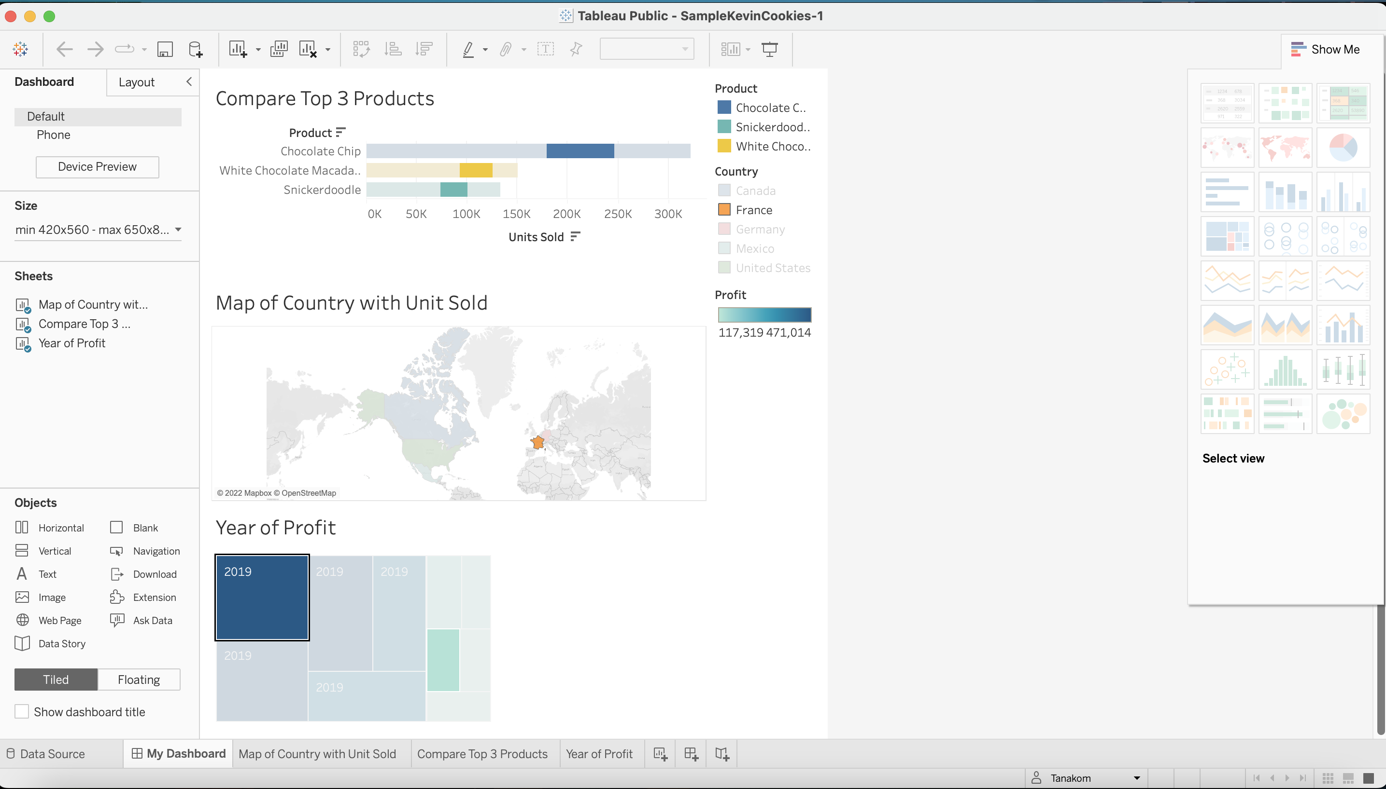
Tableau Overview
Menu Selection
Object Selection
Charts or Graphs Selection
Input Object Area
Tab Selection

Slide 22
Tableau Lab Requirements
Tableau Public Desktop or Professional Desktop
Country.csv (Download from LMS)

Slide 23
Before using Tableau
Source usage (CSV, JSON, XLSX)
Data Schema / Data Table
Feature / Information / Column / Attribute / Property
Data Type (Number, Text)
Measure (Continuous Data) and Dimension (Discrete Data)
Continuous data (1,2,3,…) uses for aggregation (sum, average, count, max, min)
Discrete data (China, USA) uses for comparison and segmentation
Step to Provide
Data Selection
Visualization
Analytic

Slide 24
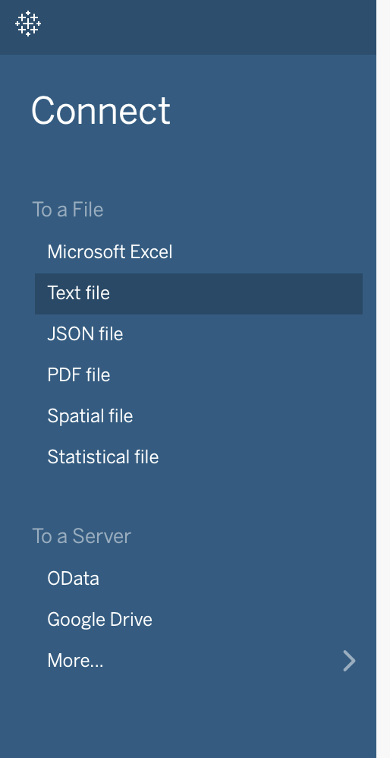
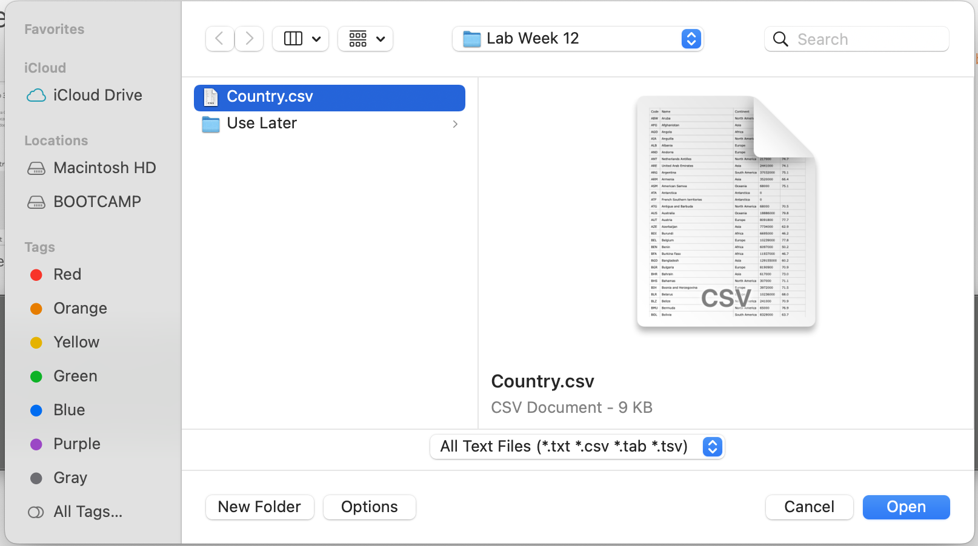
Tableau Lab (Let’s Try this)
First, let’s try to import Country.csv into Tableau

Slide 25
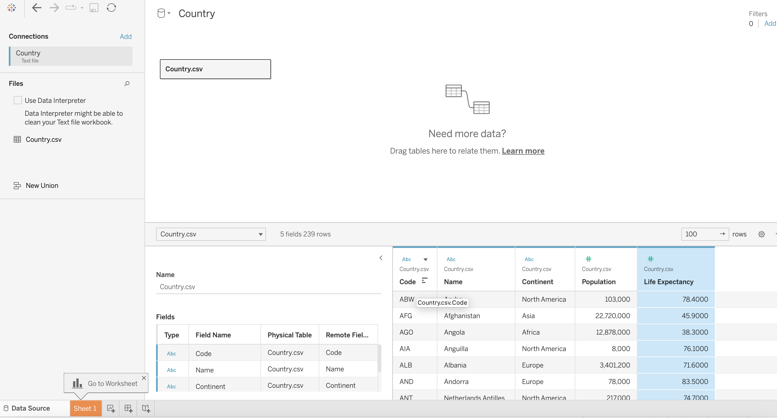
Tableau Lab (Let’s Try this)
Second, when you have imported data, check and clean data first before use
Clean data this area before click “Sheet1”

Slide 26
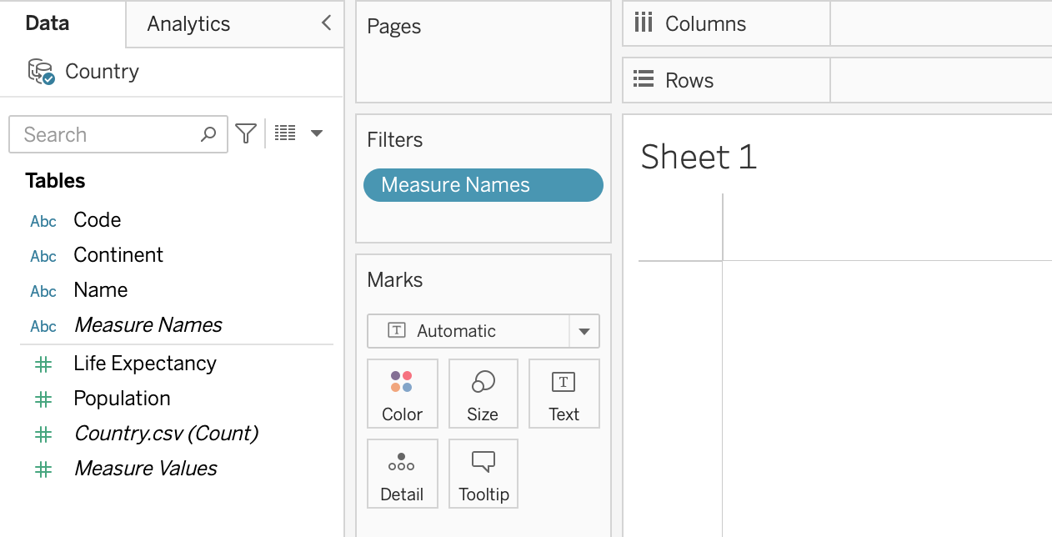
Tableau Lab (Let’s Try this)
Third, when you are in “Sheet1”, try to see the data on the left-hand side and select it to drag drop into Rows or Columns
Discrete
Data
Suppose that you would like to know the total population in each continent.
Which data would you like to display in rows and column?
Continuous
Data

Slide 27
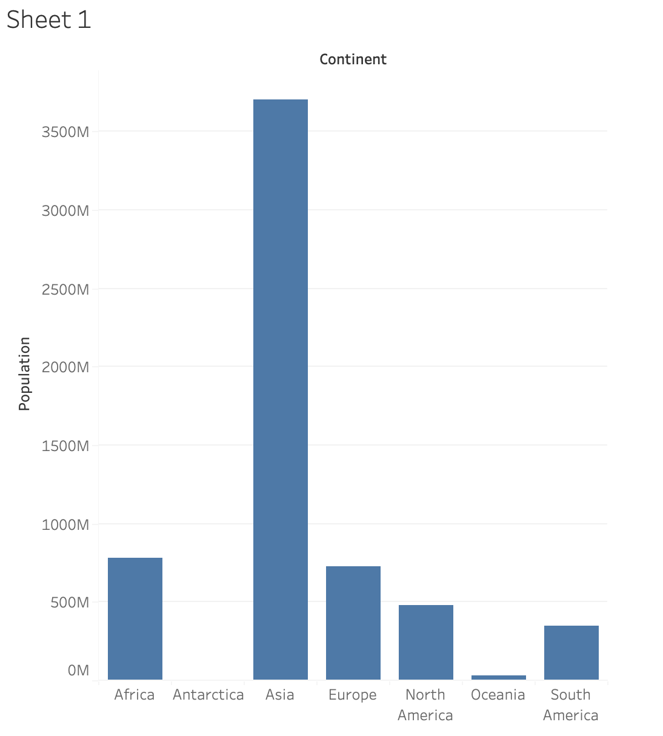
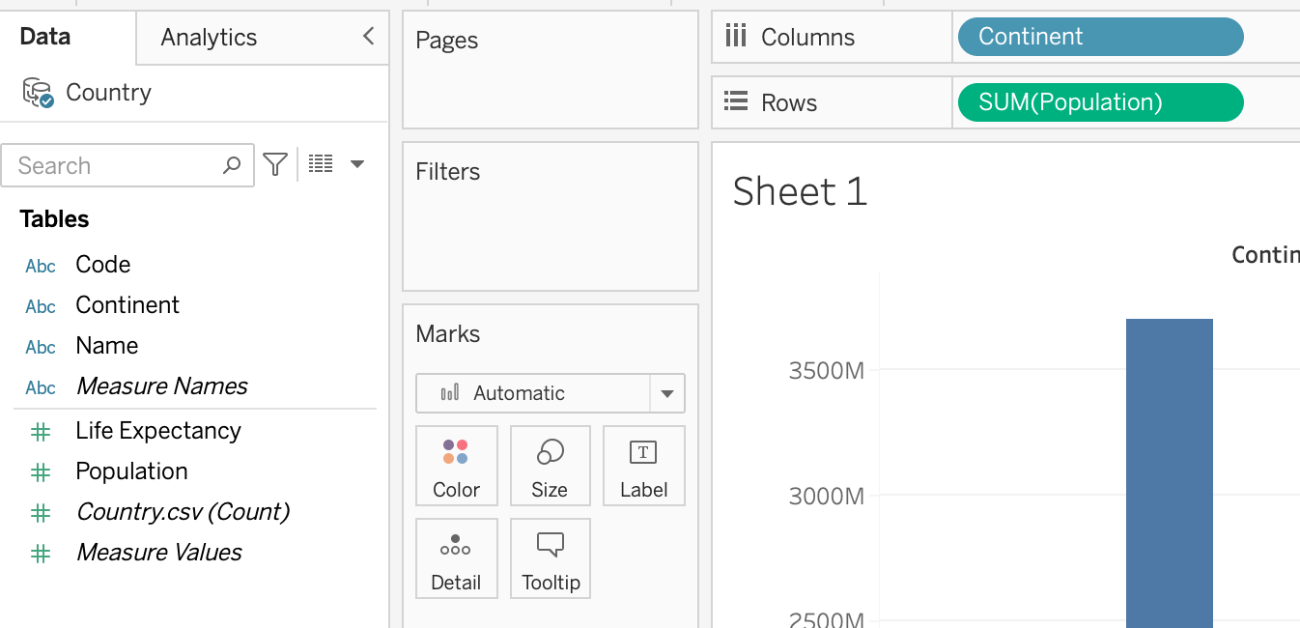
Tableau Lab (Let’s Try this)
Four, follow step 3 that you would like to display total population in each continent. Try to drag drop Population into Rows and Continent into Columns. The chart will display like this

Slide 28
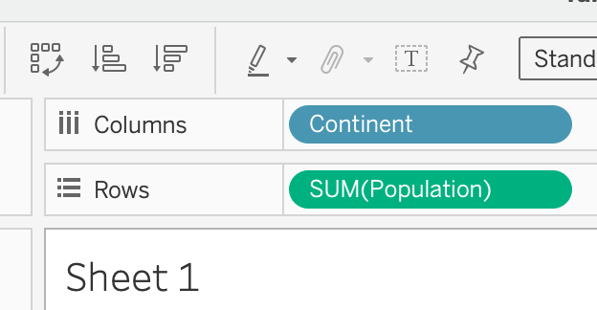
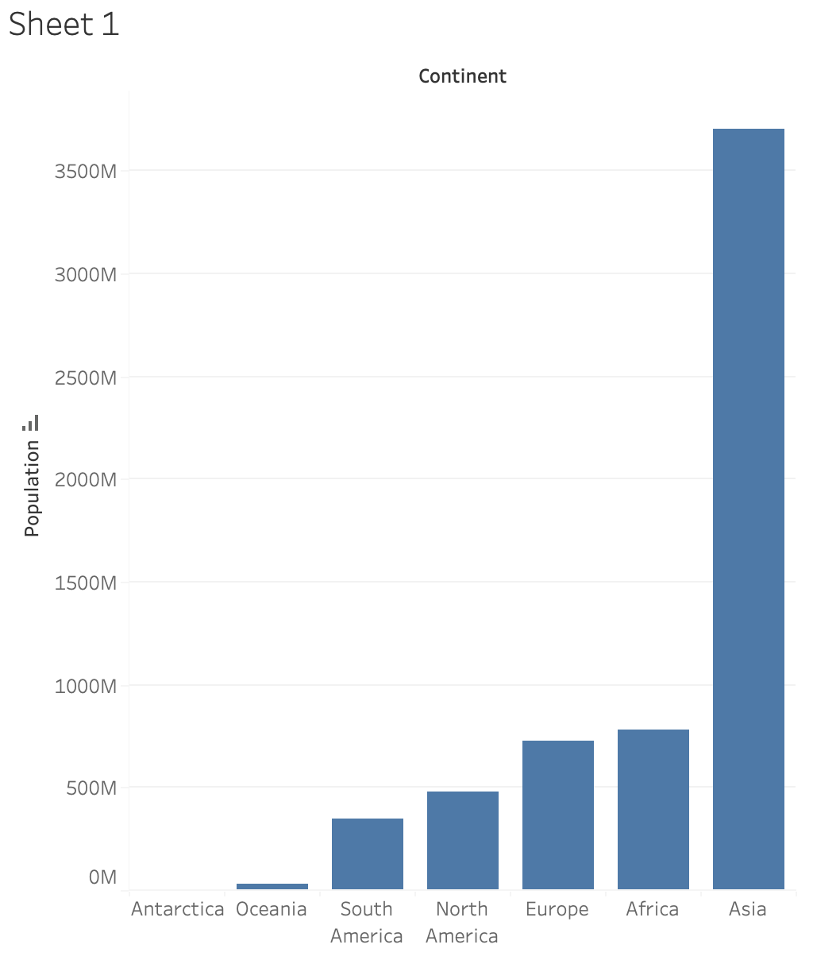
Tableau Lab (Let’s Try this)
Five, check the menu above to Swap Rows and Columns or Sort in an Ascending or Descending (e.g., Sort in an Ascending)
Try to swap Row and Column or Sort to see the different
Sorted descending
Sorted ascending
Swap Rows and Columns

Slide 29
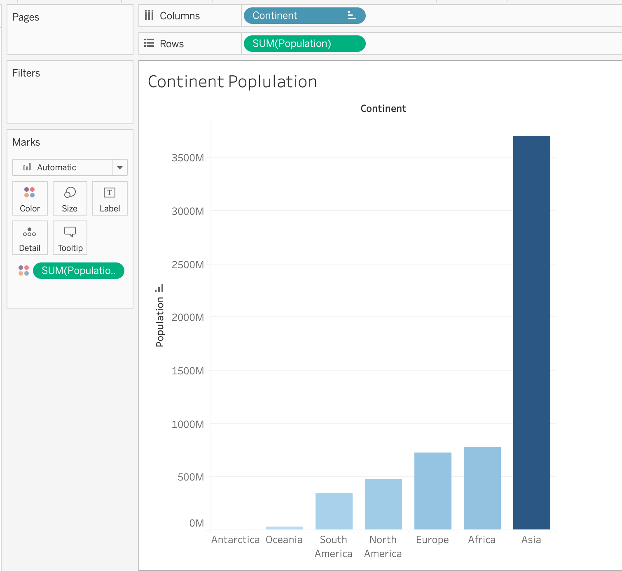
Tableau Lab (Let’s Try this)
Six, try to drag drop Population from Rows into chart area. The highlight mark of maximum population will display
Highlight mark is displayed
It displays when
drag drop is completed
Drag drop into this area

Slide 30

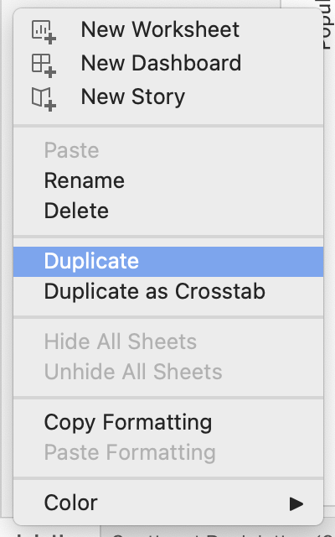
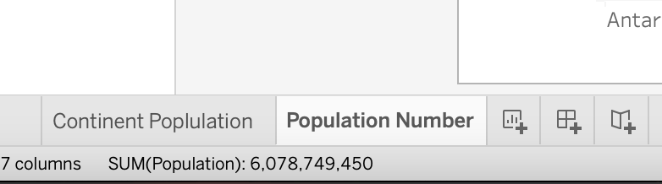
Tableau Lab (Let’s Try this)
Seven, rename Sheet1 tab to Continent Population and right click to duplicate this sheet. Then rename the duplicate sheet to Population Number

Slide 31
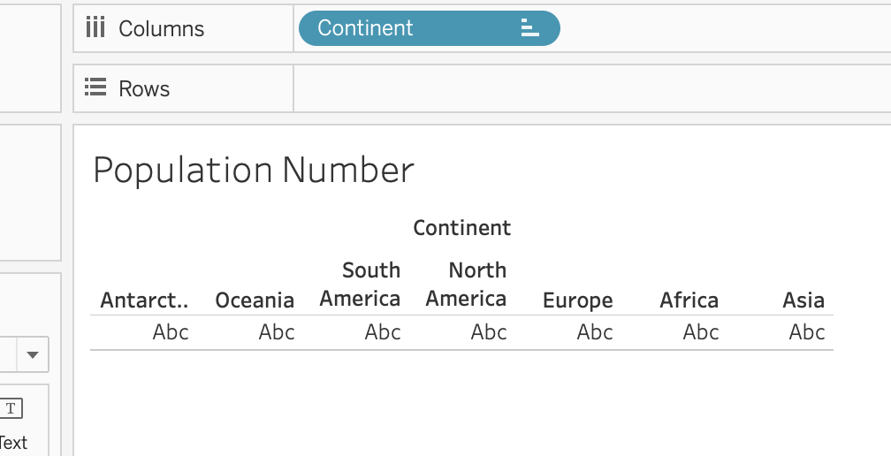
Tableau Lab (Let’s Try this)
Eight, go to Population Number and try to remove Population by right click and choose Remove or drag drop to some areas outside

Slide 32
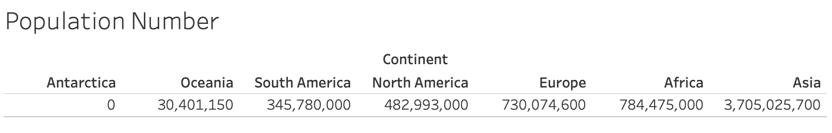
Tableau Lab (Let’s Try this)
Nine, Drag drop Population into “Abc” area and see the result

Slide 33
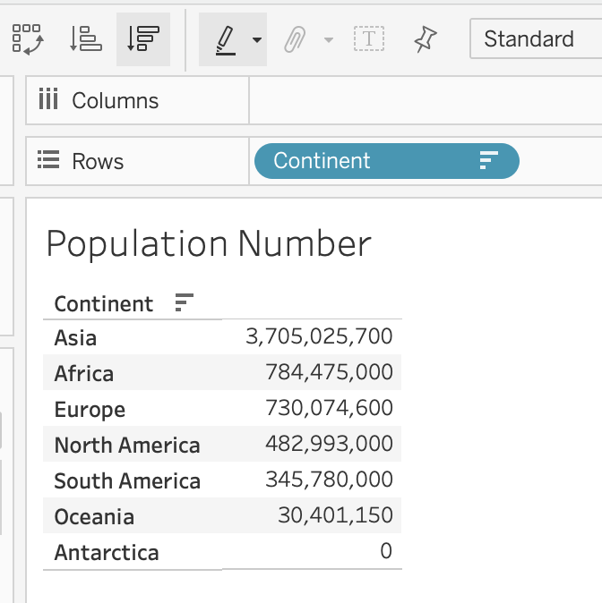
Tableau Lab (Let’s Try this)
Ten, try to Swap Rows and Columns and Sorted descending

Slide 34
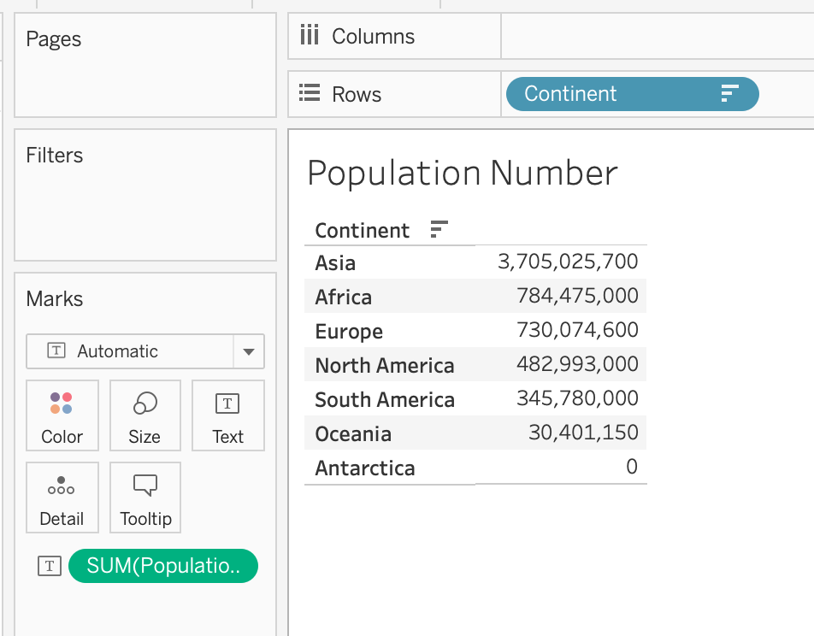
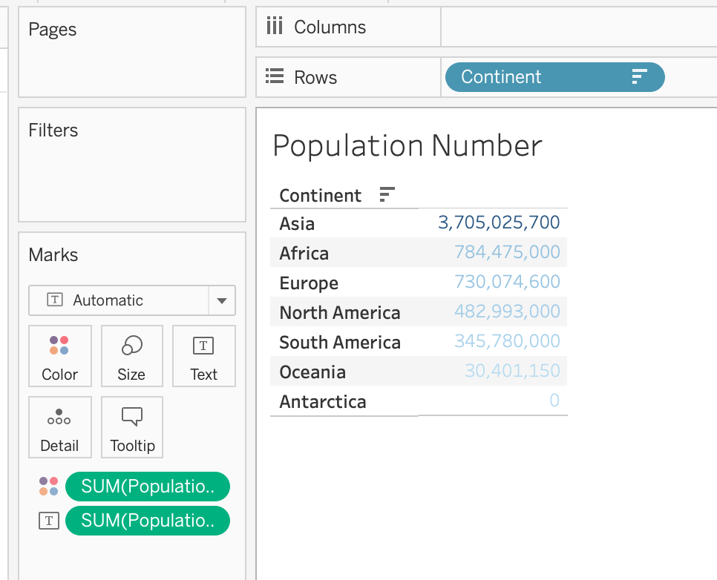
Tableau Lab (Let’s Try this)
Eleven, try to hold CTRL or command key and click to drag drop Population into Color. The result will display like this
Highlight mark is displayed
This will display when drag drop is completed
Hold CTRL or command key and click to drag drop into Color.

Slide 35
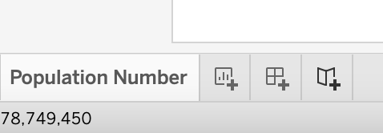
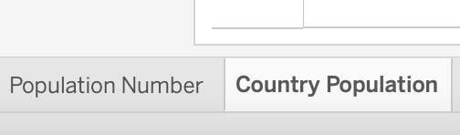
Tableau Lab (Let’s Try this)
Twelve, try to click New Worksheet icon to and rename to Country Population

Slide 36
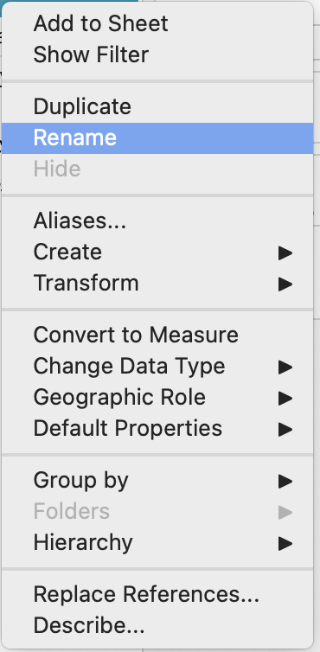
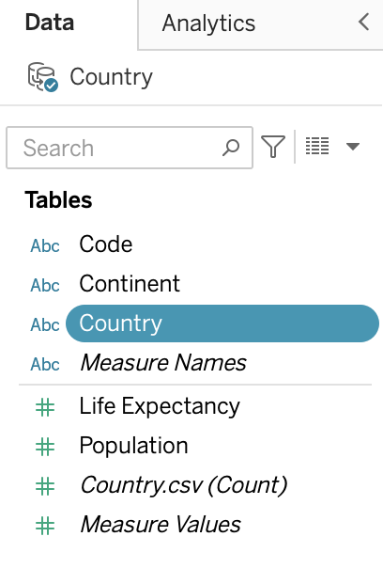
Tableau Lab (Let’s Try this)
Thirteen, try to rename one discrete data from Name to Country

Slide 37
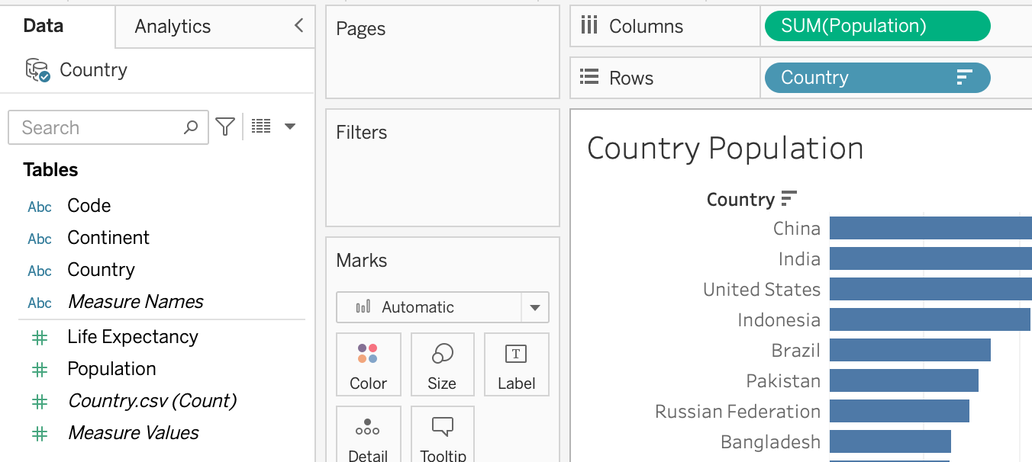
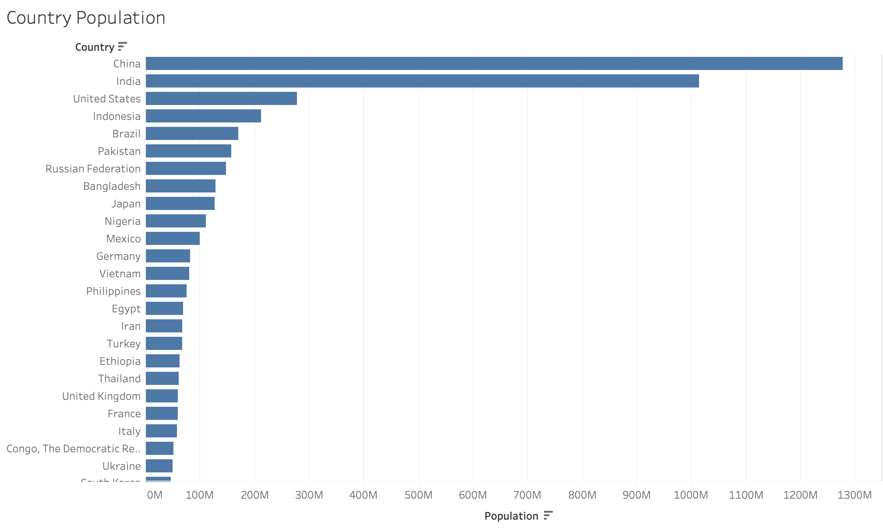
Tableau Lab (Let’s Try this)
Fourteen, try to drag drop Country into Rows and Population into Columns and Sorted descending. The result will look like this

Slide 38
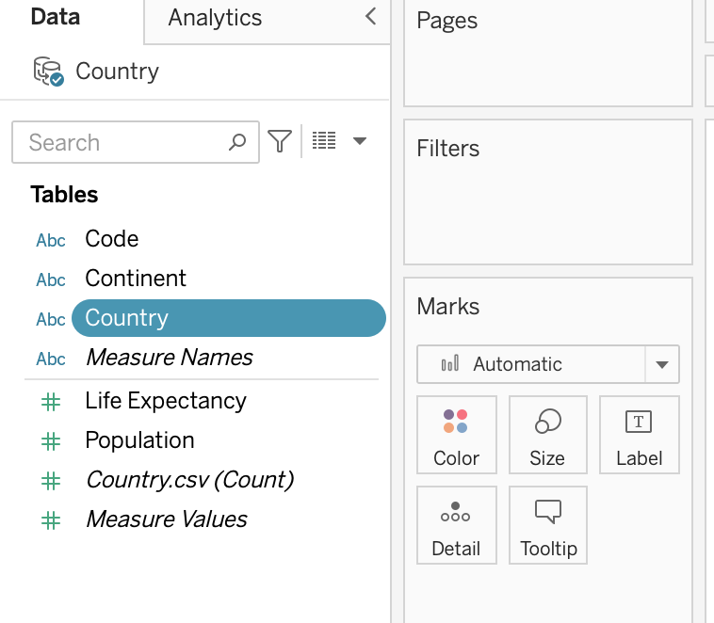
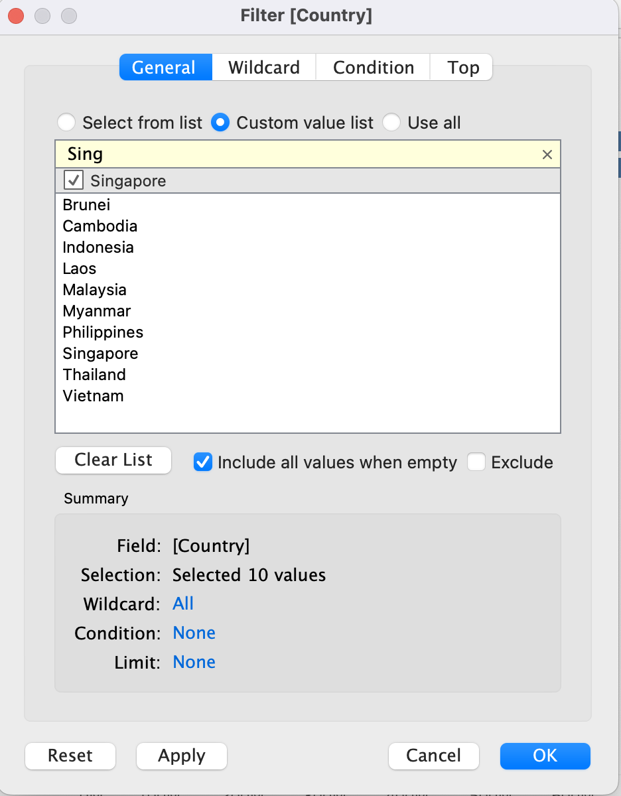
Tableau Lab (Let’s Try this)
Fifteen, from step 14, you will see that there are so many countries. It is difficult to read. You must filter some significant countries (e.g., Top 10 Population ASEAN Countries)

Slide 39
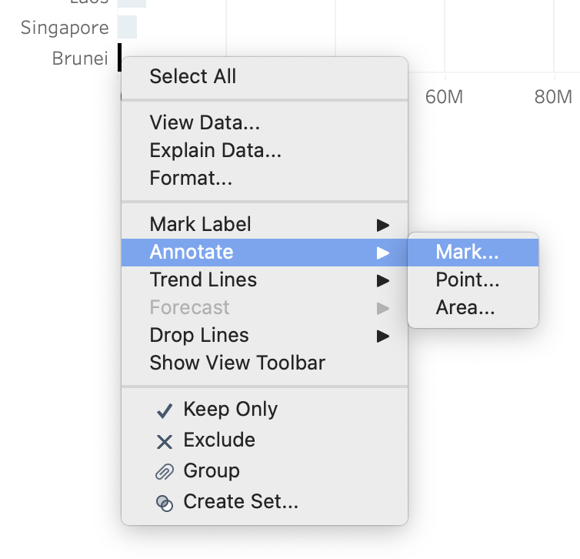
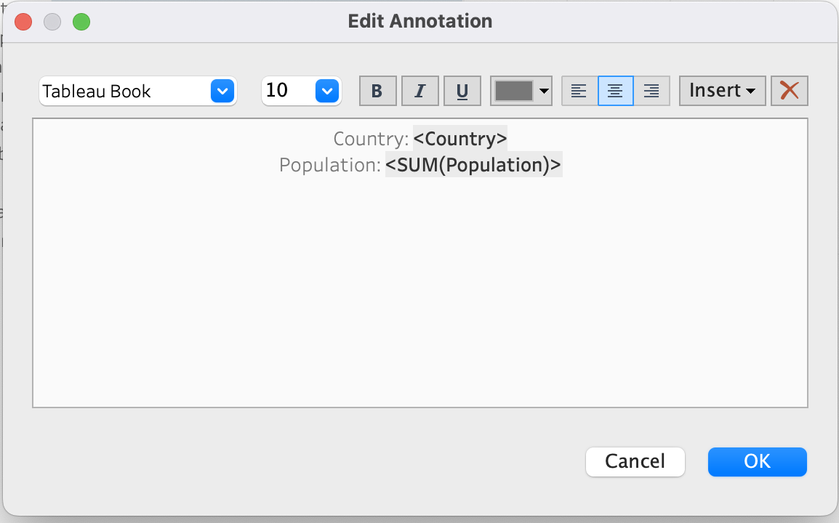
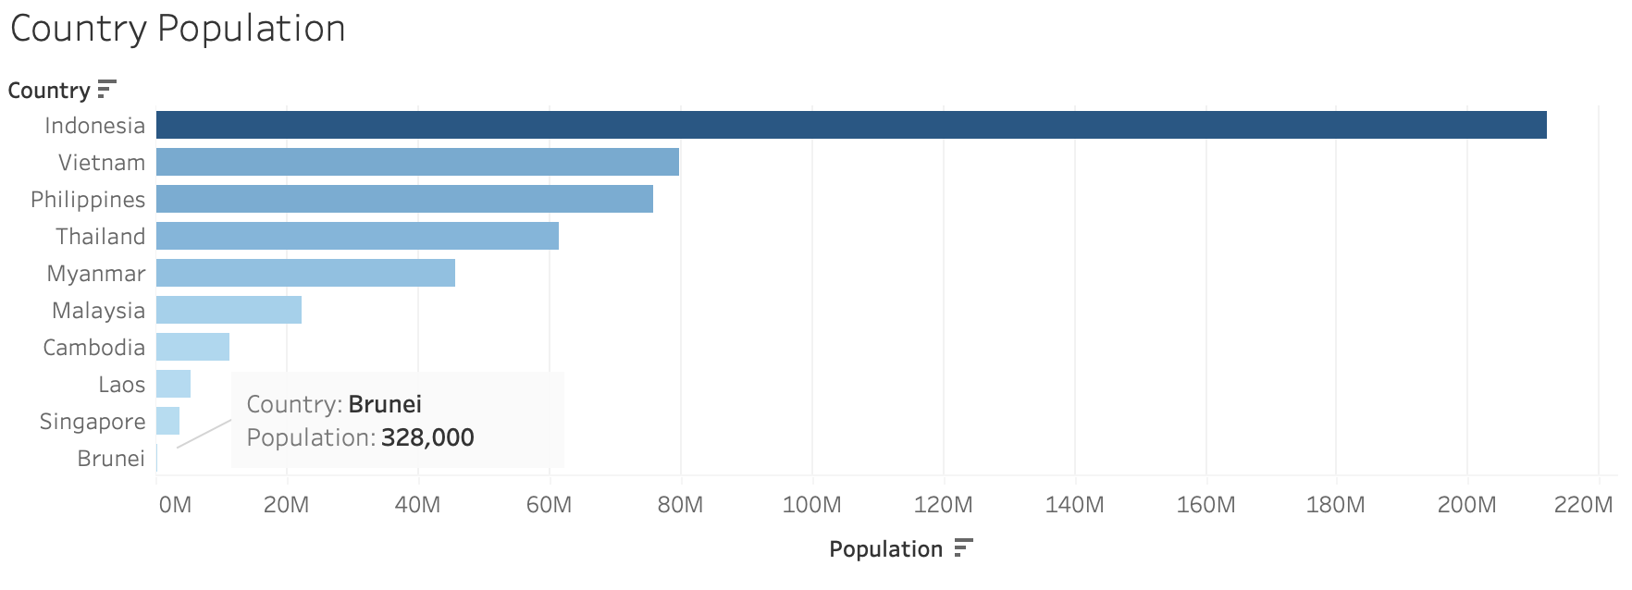
Tableau Lab (Let’s Try this)
Sixteen, try to highlight according to step 6 and right click to Brunei’s chart, select Annotate → Mark …, and click OK. The result will look like this

Slide 40
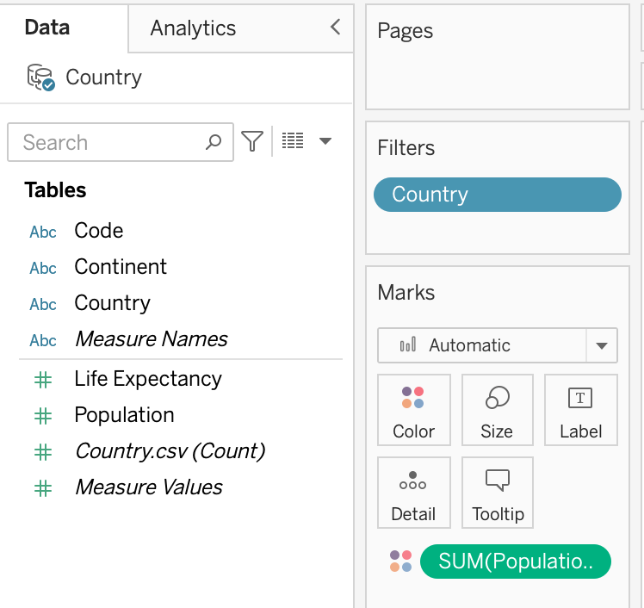
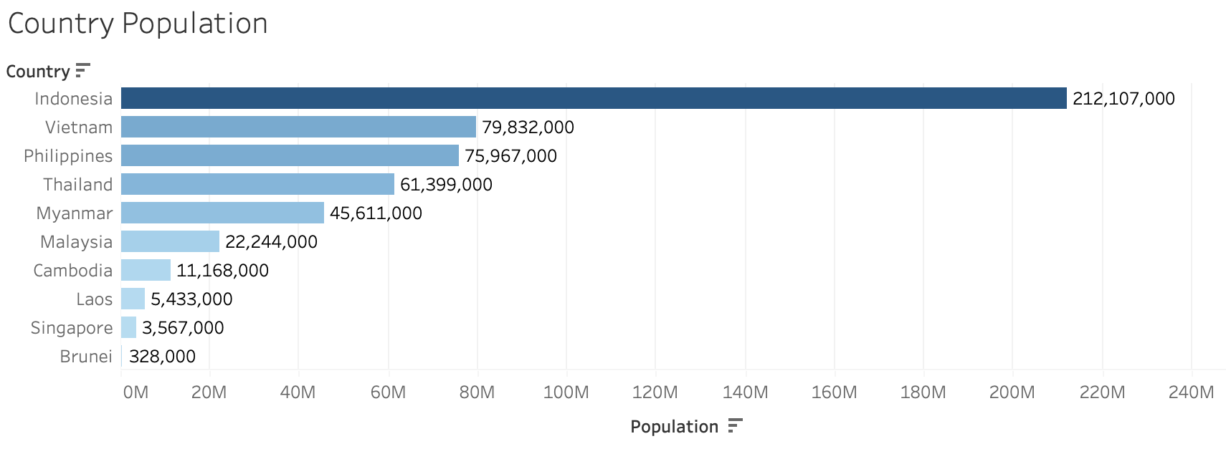
Tableau Lab (Let’s Try this)
Seventeen, (Another Method) try to hold CTRL or command key and click to drag drop Population into Label (Remove mark). The result will display like this
Hold CTRL or command key and click to drag drop into Label.

Slide 41
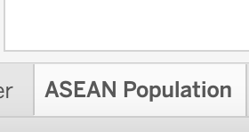
Tableau Lab (Let’s Try this)
Eighteen, try to rename Country Population sheet name again to ASEAN Population

Slide 42
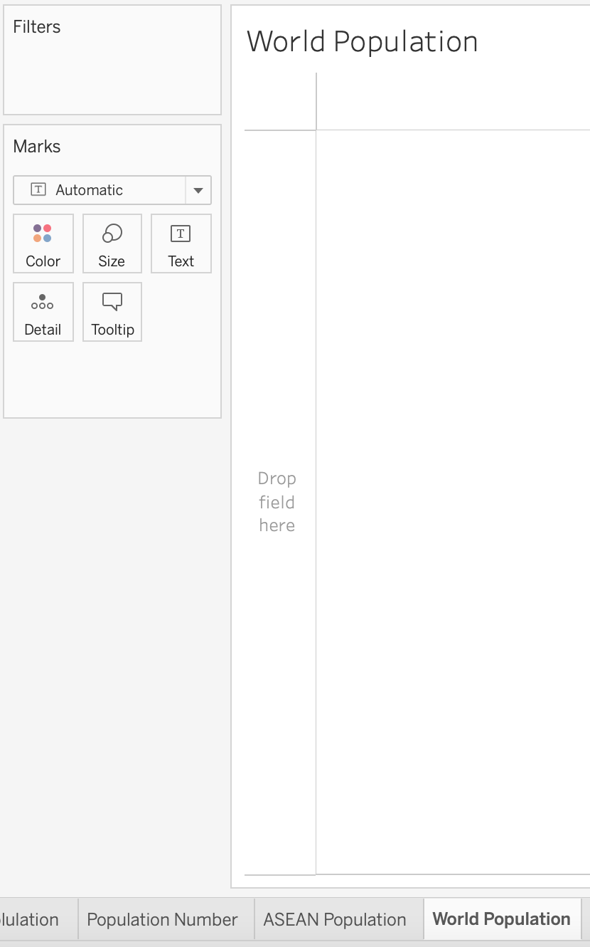
Tableau Lab (Let’s Try this)
Nineteen, try to create new sheet and then change name into World Population. This way we would like to display it in packed bubble chart

Slide 43
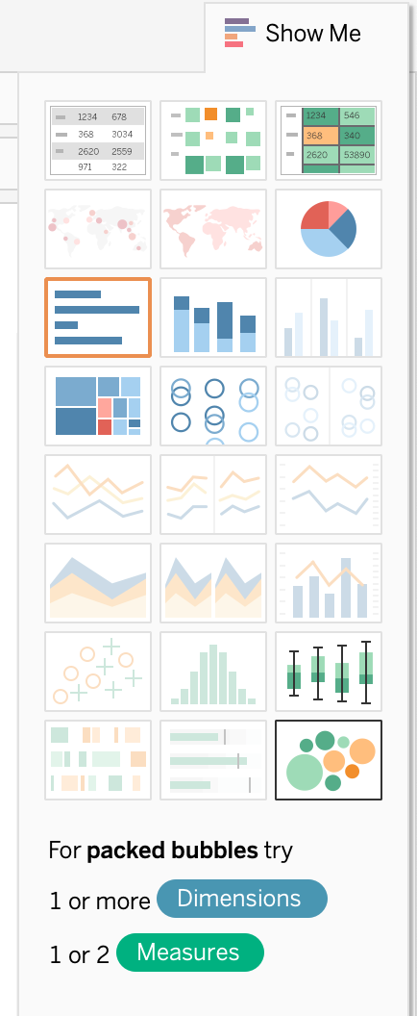
Tableau Lab (Let’s Try this)
Twenty, try to drag drop Country into Rows and Population into Columns again, and choose packed bubbles chart

Slide 44
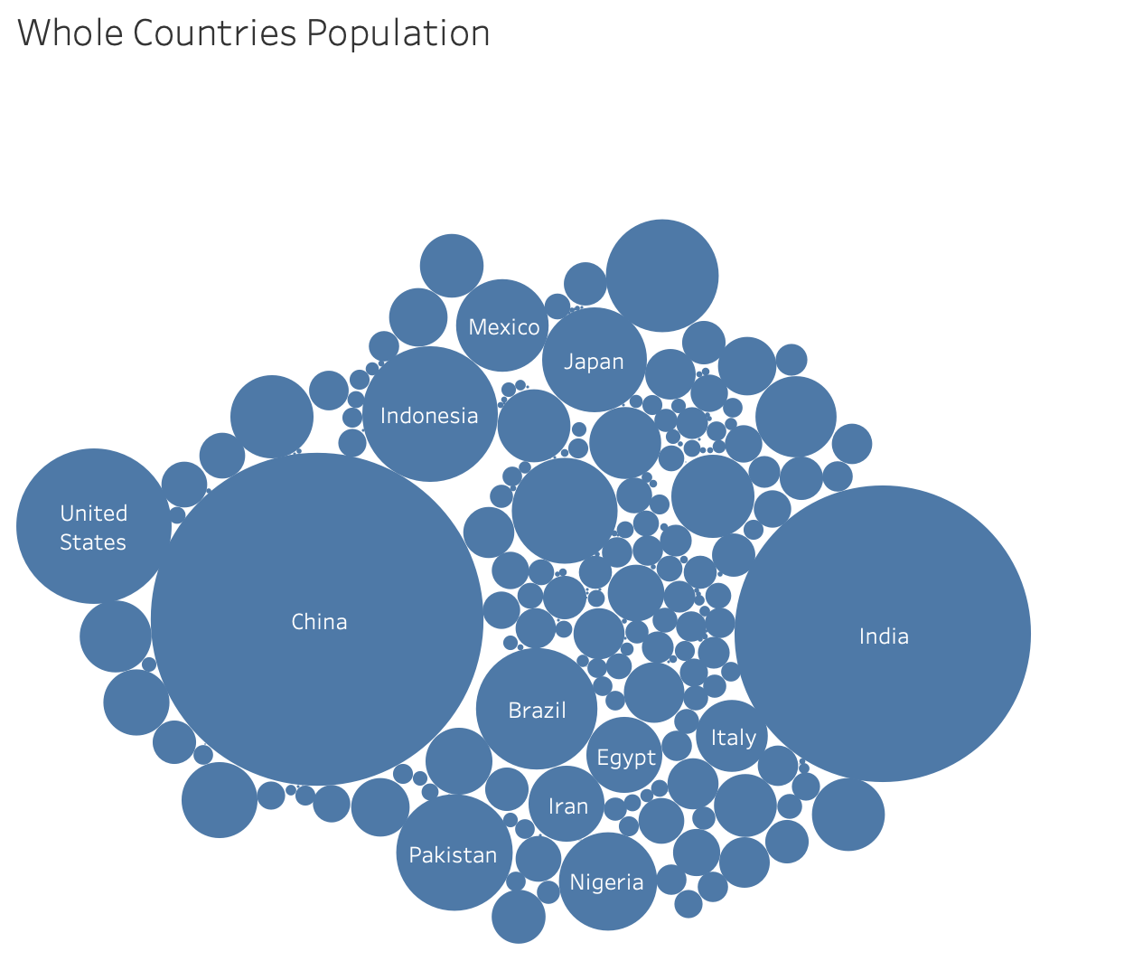
Tableau Lab (Let’s Try this)
Twenty-one, when you click packed bubble chart, the result will look like this

Slide 45
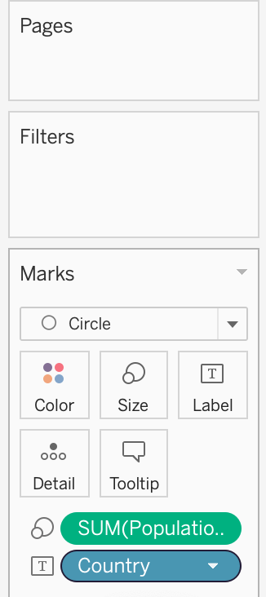
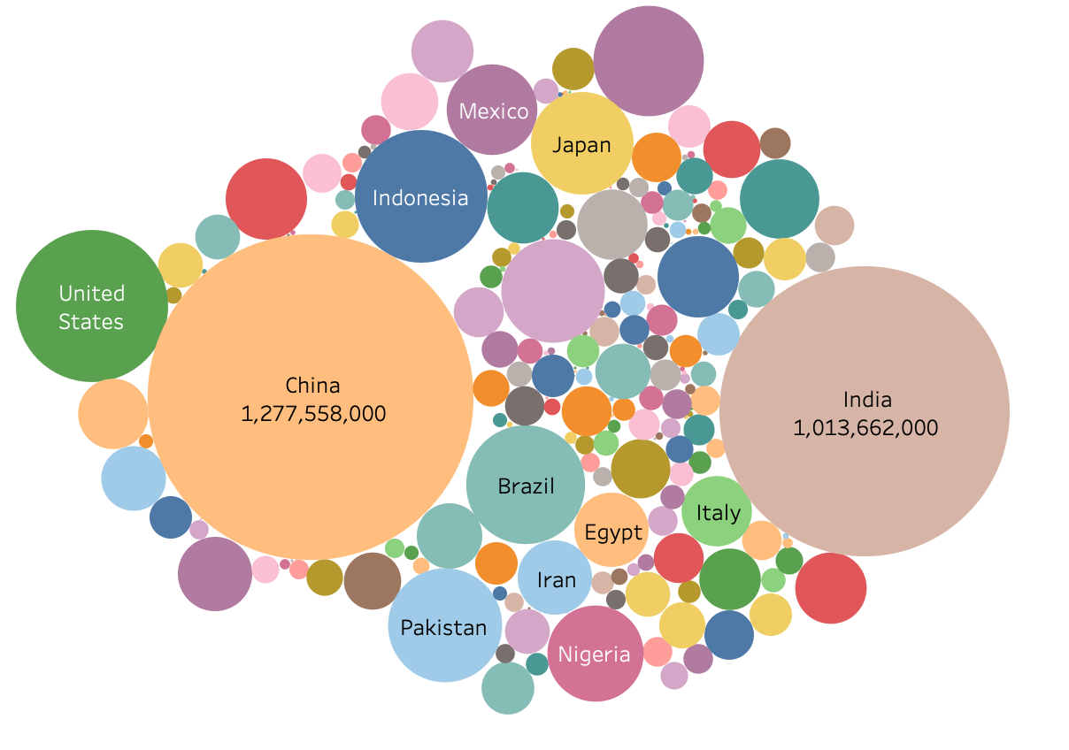
Tableau Lab (Let’s Try this)
Twenty-two, remind step 11 and 17 to hold CTRL or command key and drag Country into Color and Population into Label
Hold CTRL or command key and click to drag drop.

Slide 46

Tableau Lab (Let’s Try this)
Twenty-three, try to create new sheet and then change name into World Life Expectancy.

Slide 47

Tableau Lab (Let’s Try this)
Twenty-four, try to drag drop Continent into Rows and Life Expectancy into Columns

Slide 48


Tableau Lab (Let’s Try this)
Twenty-five, try to change the calculation of Life Expectancy from SUM (Summation) to AVG (Average). It is impossible to display life age in summation

Slide 49


Tableau Lab (Let’s Try this)
Twenty-six, try to change the chart into treemaps. It displays look like this

Slide 50



Tableau Lab (Let’s Try this)
Children: 0 – 13 years
Teenager: 14 – 24 years
Working Age: 25 – 39 years
Middle Age: 40 – 59 years
Senior: 60 – 100 years
Twenty-seven, let’s create the new calculation with syntax condition named Life Age Condition in Analysis → Create Calculated Field…, input this syntax condition, and then click OK
This condition syntax is to display the life age in category: Children, Teenager, Working Age, Middle Age, Senior

Slide 51


Tableau Lab (Let’s Try this)
Twenty-eight, try to drag drop Life Age Condition into Marks area and see the result

Slide 52



Tableau Lab (Let’s Try this)
Twenty-nine, try to hold CTRL or command key and click to drag drop Life Age Condition into Color and Label, and Life Expectancy into Label. The result will display like this
Hold CTRL or command key and click to drag drop.

Slide 53


Tableau Lab (Let’s Try this)
Thirty, let’s create the new calculation again with syntax named Country Count in Analysis → Create Calculated Field…, input this syntax condition, and then click OK
This syntax is to display number of country in each continent.

Slide 54


Tableau Lab (Let’s Try this)
Thirty-one, try to drag drop Country Count into Marks area and hold CTRL or command key and click to drag drop Country Count into Label

Slide 55

Tableau Lab (Let’s Try this)
Thirty-two, when you complete from step 31, the result will look like this

Slide 56


Tableau Lab (Let’s Try this)
Thirty-three, let’s create the new calculation again with syntax named Population Summation in Analysis → Create Calculated Field…, input this syntax condition, and then click OK
This syntax is to display summation of population in each continent.

Slide 57


Tableau Lab (Let’s Try this)
Thirty-four, try to drag drop Population Summation into Marks area and hold CTRL or command key and click to drag drop Population Summation into Label

Slide 58

Tableau Lab (Let’s Try this)
Thirty-five, when you complete from step 34, the result will look like this

Slide 59

Tableau Lab (Let’s Try this)
Thirty-six, try to create new dashboard and then change name into World DataViz

Slide 60

Tableau Lab (Let’s Try this)
Thirty-seven, try to change size to Automatic and drag drop and adjust whole Sheets into your favorite style
When you drag drop sheets into dashboard, the status displays like this

Slide 61

Tableau Lab (Let’s Try this)
Thirty-eight, when you complete from step 37, the result will look like this

Slide 62


Tableau Lab (Let’s Try this)
Thirty-nine, congratulations! You can click icon to display Presentation
Press ESC key to exit Presentation Mode

Slide 63

Tableau Lab (Let’s Try this)
Forty, try to click chart in some countries in ASEAN like Thailand. The result will focus only country with information you select
Try to move or click your mouse cursor to other areas and see the result!

Slide 64



Tableau Lab (Let’s Try this)
Forty-one, do not forget to save file by click File → Save to Tableau Public. This will let you save into Tableau Public Cloud directly
When the save file is completed, it opens your cloud save location file automatically in your web browser.
Disadvantage:
It shows your data visualization file in the public, and anyone can see and use it!

Slide 65




Tableau Lab (Let’s Try this)
Forty-two, from the Tableau Public Cloud in web browser, let’s try to download the file and choose file type into your device

Slide 66




Tableau Lab (Let’s Try this)
Forty-three, from the Tableau Public Cloud in web browser, let’s try to share the file and copy link to paste into any collaboration software or social media or generate QR code to display in Smartphone
The link will look like this …
https://public.tableau.com/views/CountryDataViz_16578783818970/WorldDataViz?:language=en-GB&:display_count=n&:origin=viz_share_link
OR

Slide 67

Tableau Lab (Let’s Try this)
Let’s try this (in class)
Download Kevin Cookies Financial-Revised.csv from LMS and try to create Data Visualization like this picture below:
Hint: Total Revenue Sold = Units Sold * Revenue per cookie

